Slide 1
Lesson 1 - Intro

Slide 2



Who we are?
Sasha (SPD-Ukraine)
Vasya (SPD-Ukraine)
Yarik (SPD-Ukraine)

Slide 3
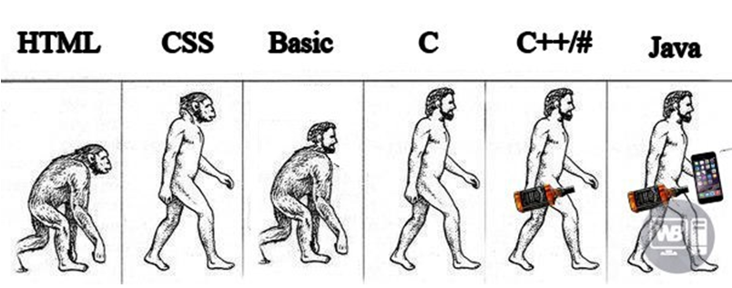
Course goals
Read
Understand
Update
Create

Slide 4
Course action plan
Core
Basics
OOP
Code testing
Exceptions
Collections, Generics
Functional Programming
IO
Concurrency
Database
Web
Servlet API
REST
Spring Framework (MVC, Boot, JDBC, Security)
…

Slide 5
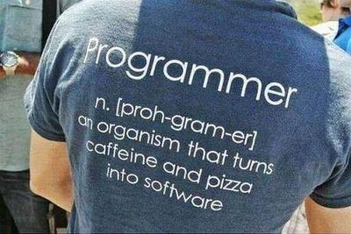
Lesson goals
What is Java
Basic Java
Variables
Datatypes
Operators
Structure
Dev tools

Slide 6
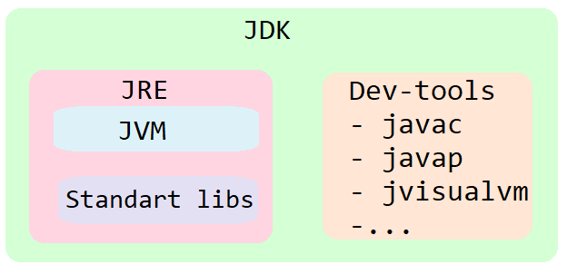
JVM vs JRE vs JDK

Slide 7
Java Platform Editions
1. Standart Edition
2. Enterprise Edition
3. Midlet Edition

Slide 8
Java Evolution
1996
1997
1998
2000
2002
2004
2006
2011
2014
2017
2018
2018
2019
2019
2xxx
1.0
1.1
1.2
1.3
1.4
1.5
1.6
7
8
9
10
11
12
13

Slide 9





How it works?
javac.exe
java.exe
JVM
Hello.java
Hello.class

Slide 10
Java pros
👍 Cross-platform
👍 Secure
👍 Powerful
👍 Multithreaded
👍…

Slide 11
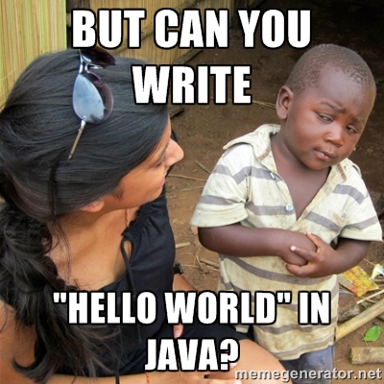

Slide 12
Hello World
public class HelloWorld { public static void main(String args[]) { System.out.println("Hello World!!!"); } }
c:\> javac HelloWorld.java
c:\> java HelloWorld Arg1 Arg2 777

Slide 13
Program
int a = 1;
int b = 1;
int c = 6; int D = b * b - 4 * a * c; /* discriminant */ if (D >= 0) { int x1 = (-b + Math.sqrt (D)) / (2 * a); int x2 = (-b - Math.sqrt (D)) / (2 * a); }
Code
+
Whitespaces
+
Comments
The same to
int a=1,b=1,c=6;int D=b*b-4*a*c;if(D>=0) {int x1=(-b+Math.sqrt(D))/(2*a);int x2=(-b-Math.sqrt(D))/(2*a);}

Slide 14
Java Syntax
Static typed
Case sensitive
Statements separated by semicolon ;
Wrap blocks in braces {}
Spaces (4) vs tabulation
Comments
// one line
/* multiline */
/**Java doc */

Slide 15
Code convention
Read. Remember. Follow.
By Oracle
By Google
By Twitter

Slide 16
Variables
type
value
int size = 41;
name

Slide 17
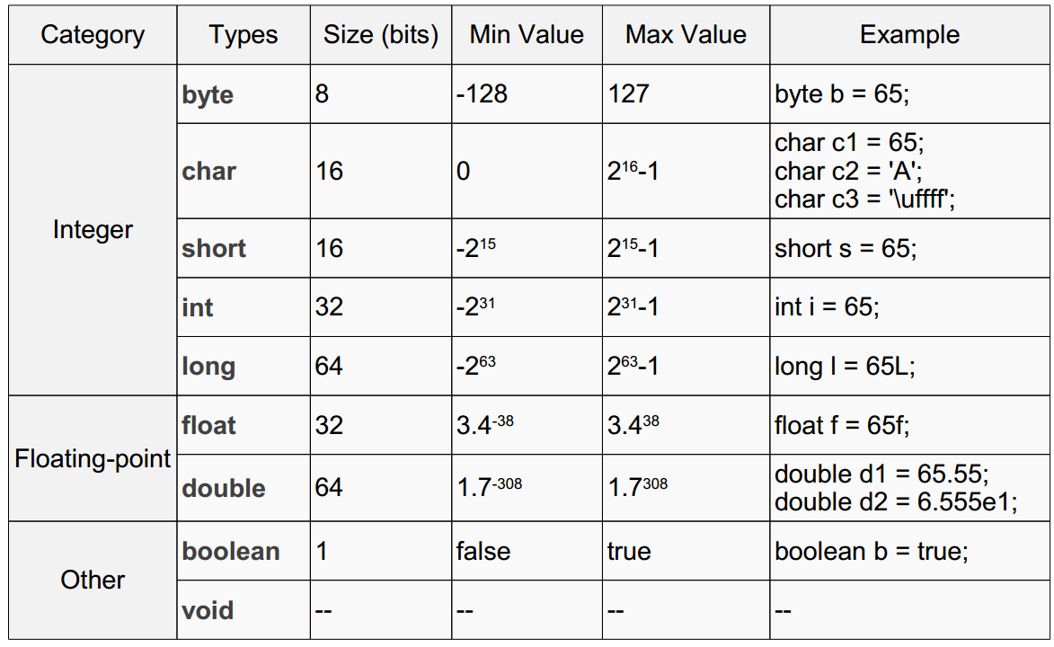
Primitive types

Slide 18
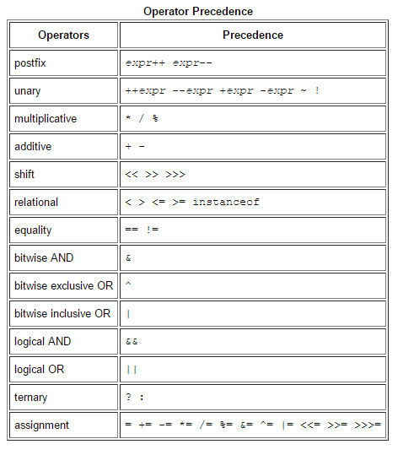
Operators

Slide 19
Keywords
Primitive types and void | Modifiers | Declarations | Control Flow | Misc
boolean | public | class | if, else | this, super
byte | protected | interface |  | new
char | private | enum | try, catch, finally | _ (underscore)
short | abstract | extends | do, while | import
int | static | implements | continue, break, return | instanceof
long | final | package | throw | null
float | transient | throws | default | true, false
double | volatile |  | for | assert
void | synchronized |  | case | strictfp
 | native |  | switch | goto
 |  |  |  | const

Slide 20
What will be printed?
public class HelloWorld { public static void main(String args[]) { int a = 5; int b = a; a = 3;
System.out.println(b); } }

Slide 21
Object
public class Point { private int x; private int y; // getters/serters void draw() { // … } }

Slide 22
What will be printed?
Point p1 = new Point(3,5); Point p2 = p1; p1.setX(7); print(p2.getX()); Point p3 = new Point(3,5); Point p4 = p3; p3 = new Point(7,9); print(p4.getX());

Slide 23
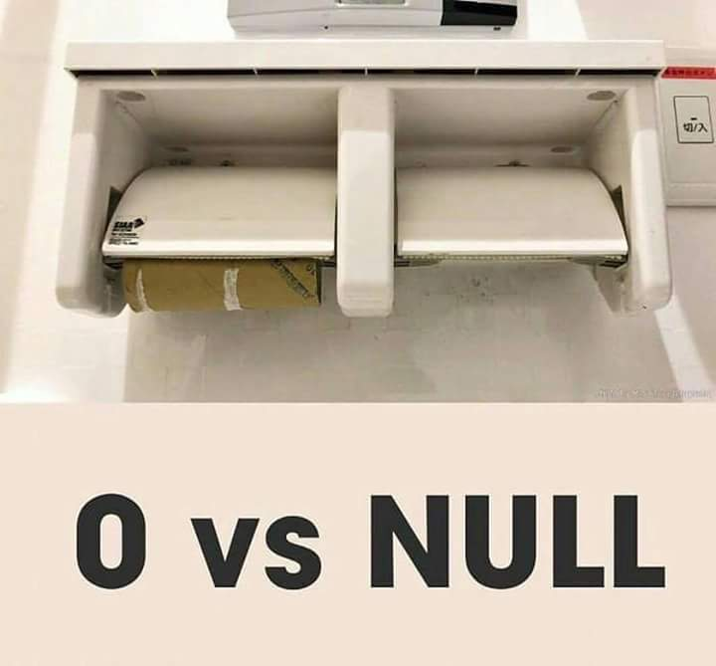
Null is not a Zero
Only objects can be null
Primitive types – cannot
String nullText = null;
String emptyText = “”;

Slide 24
Arrays
int array[] = new int[5]; //[0, 0, 0, 0, 0] for (int i = 0; i < 5; i++) { // indexing starts from 0 array[i] = i * i; // [0, 1, 4, 9, 16] }
Object array[] = new Object[3]; // [null, null, null]
String matrix[][] = {{"aaa", "bbb", "cde"}, {"1", "2"}};

Slide 25
Conditional operator if else
int n = readNumber(); if (n == 1) { System.out.println("1"); } else if (n == 2 || n == 3) { System.out.println("2 or 3"); } else if (n == 4) { System.out.println("4"); } else { System.out.println("5"); }

Slide 26
Conditional operator switch
int n = readNumber(); switch (n) { case 1: System.out.println("1"); break; case 2: case 3: System.out.println("2 or 3"); break; case 4: System.out.println("4"); break; default: System.out.println("5"); }

Slide 27
Loop while “do”
while (condition) { statement; }
int count = 0; while (count < 5) { System.out.println(count); count++; }

Slide 28
Loop while “do”
do { statement; } while (condition);
int count = 0; do { System.out.println(count); count++; } while (count < 5);

Slide 29
Conditional loop for
for (initialization; condition; increment){
statement;
}
for (int count = 0; count < 5; count++) { System.out.println(count); }

Slide 30
Branching statement break
int maxRetries = 10; for(int i = 0;;) { if(i > maxRetries){ break; // stop iteration
} doSomething();
i++; }

Slide 31
Branching statement continue
for(int i=0;; i++) { if(i % 5 == 0){
doSomethingAnother();
continue; // continue iteration
} doSomething(); }

Slide 32
Branching statement return
for(int i = 0; i < 10; i++) { if(i > 5) { return -1; // stop iteration and exit from method } doSomething(); }
return result;

Slide 33
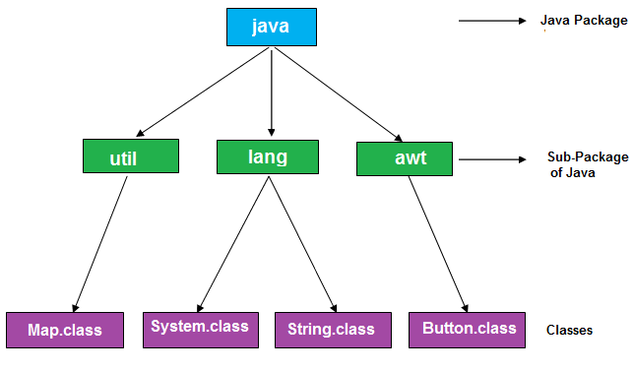
Packages

Slide 34
Imports
import <package.name>.<classname>;
java.lang is imported by default
Importing a Package Member
import java.util.Map; import java.util.HashMap;
….
Map map = new HashMap();
Importing an Entire Package
import java.util.*;
….
Map map = new HashMap();

Slide 35
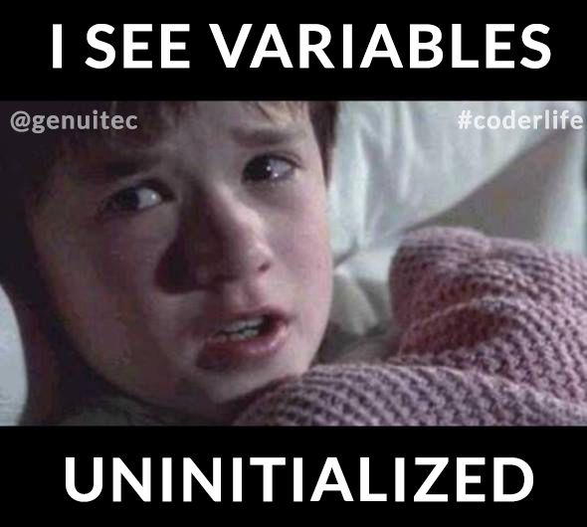
Garbage Collector

Slide 36

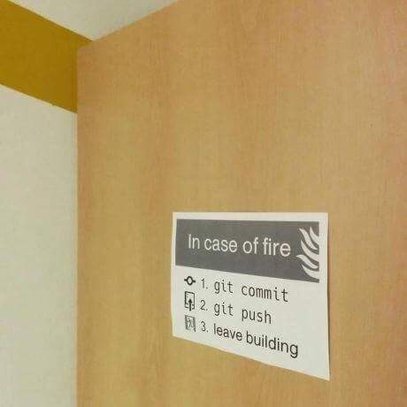
Control Version System (CVS)

Slide 37

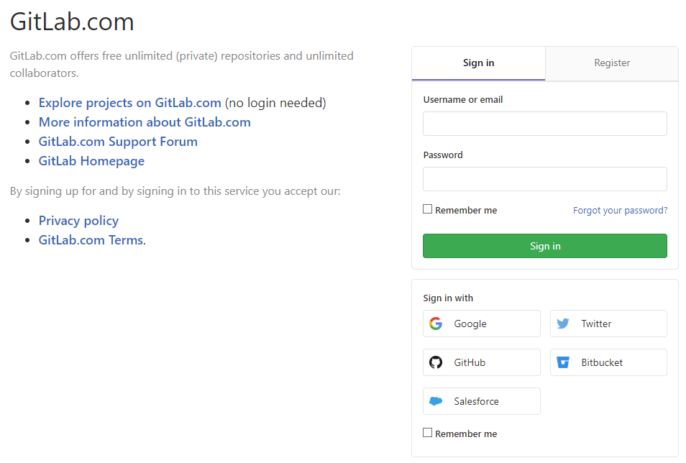
Cloud repository

Slide 38
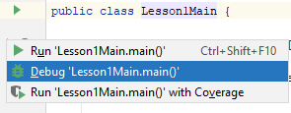
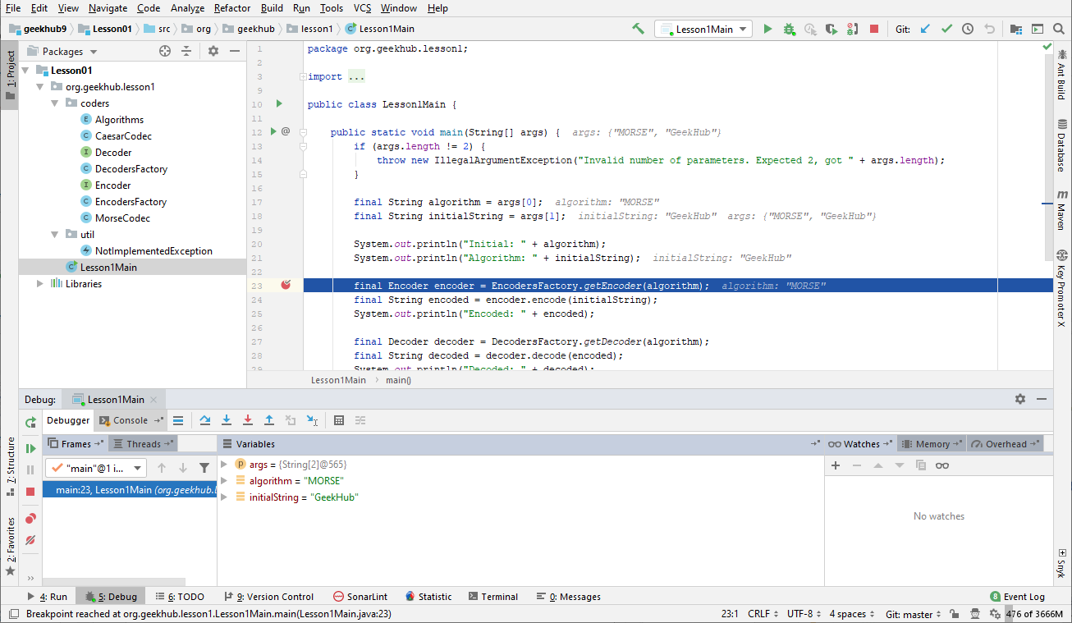
Debugging

Slide 39
Literature
Java Basics:
Getting started
Language Basics
Classes and Objects
Java Code Convention:
By Oracle
By Google
By Twitter
Books:
“Clean Code” by Robert Martin
“Java: The Complete Reference” by Herbert Schildt

Slide 40
Homework
Complete implementation of encoding/decoding system provided in Gitlab Lesson01 module. Alphabets and rules available on site
public interface Encoder { String encode(String input); }
public interface Decoder { String decode(String input); }

Slide 41
Quality is more important than amount

Slide 42
Thanks!
Questions?
Find us in Slack:
@Yaroslav Brahinets
@Vasya Rudas
@Oleksandr Kucher

